Slide 1
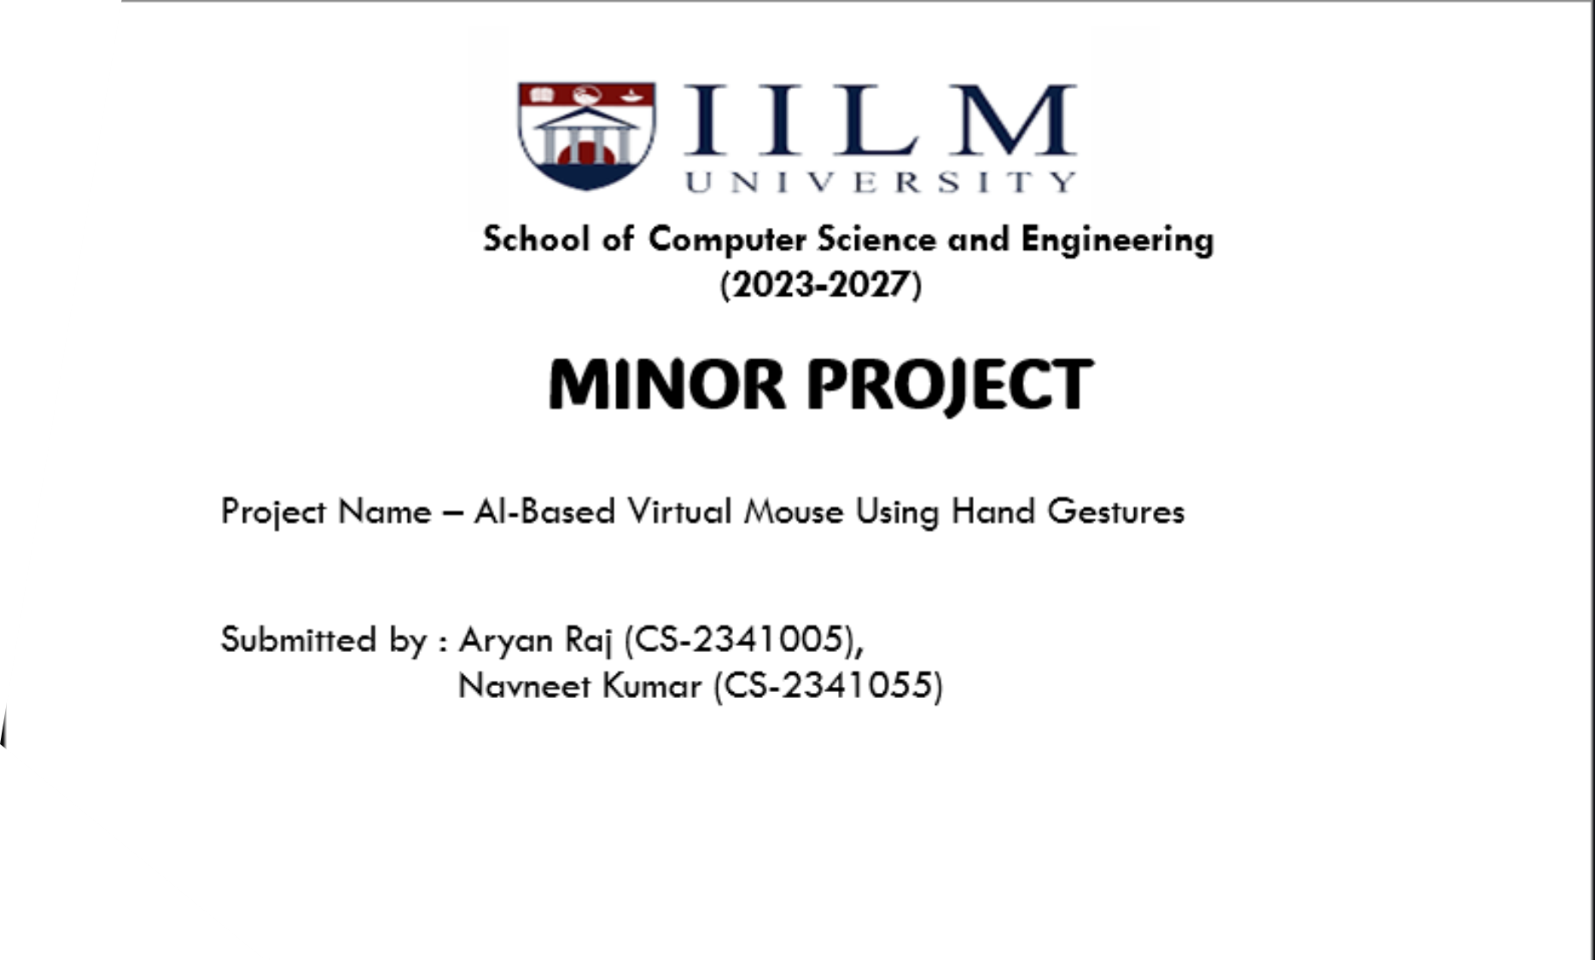
SUBMITTED TO :- POONAM YADAV

Slide 2
Problem Statement
Traditional mouse devices can be restrictive or inaccessible.
There is a need for an alternative, contactless, intuitive way to interact with computers.

Slide 3
Objectives
- Implement complete mouse functionality using hand gestures.
- Achieve precise and smooth cursor movement.
- Enable left-click, right-click, double-click, drag, and scroll.
- Provide real-time performance and visual feedback.

Slide 4
Scope of the Project
- Full mouse control using hand gestures.
- Real-time feedback with gesture visualization.
- Robust and responsive system.

Slide 5
Requirements
Software:
- Python 3.x
- OpenCV
- MediaPipe Hands
- PyAutoGUI
- NumPy
Hardware:
- Computer with Webcam
- Optional GPU

Slide 6
Methodology
- Capture video using webcam
- Detect hand and track landmarks
- Recognize gestures
- Map gestures to mouse actions
- Provide visual feedback

Slide 7
Flow Diagram
Start → Capture Frame → Detect Hands → Identify Gestures →
Map to Mouse Action → Visual Feedback → Repeat

Slide 8
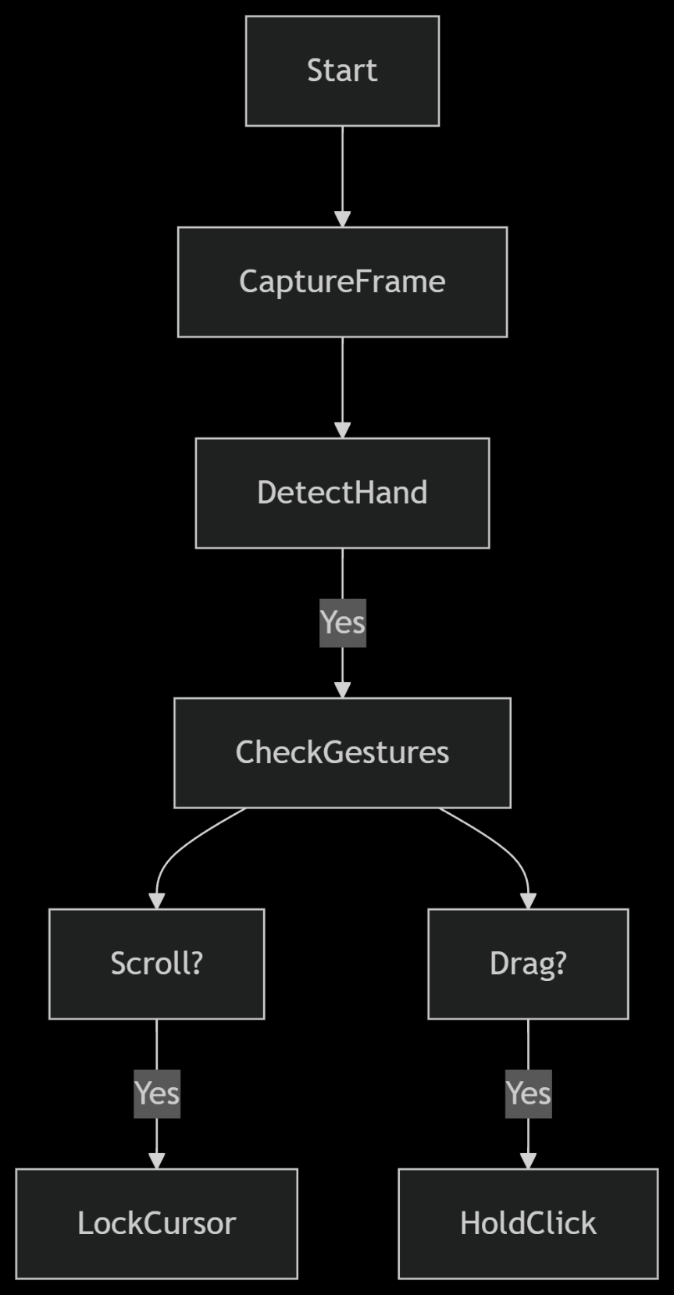
Flow Chart
The flowchart illustrates the system’s process: capturing webcam frames, detecting hands, identifying gestures, and executing mouse actions, looping back for continuous operation.

Slide 9
Features Implemented
- Cursor movement with index finger
- Left-click by thumb-index touch
- Right-click by thumb-middle finger touch
- Drag-and-drop using pinch gestures
- Scroll with specific hand movements
- Visual feedback with mouse icon color

Slide 10
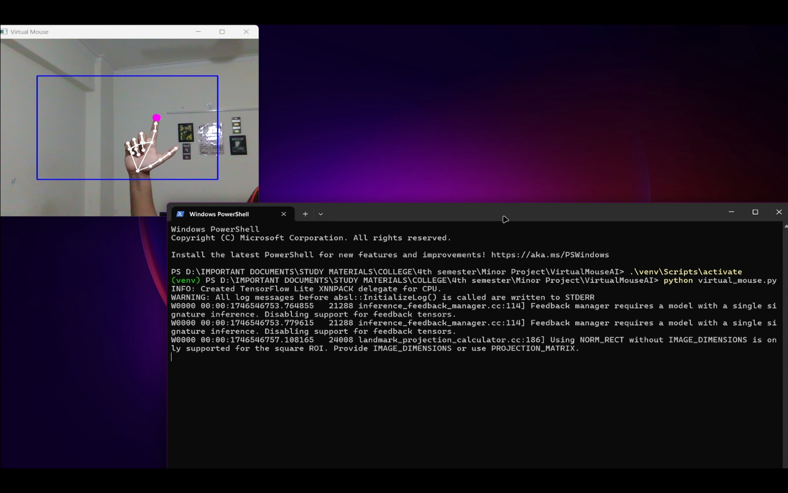
Cursor Movement Window
Description: Webcam feed showing hand landmarks, index finger raised, cursor movement active, with a pink circle on the index finger.

Slide 11
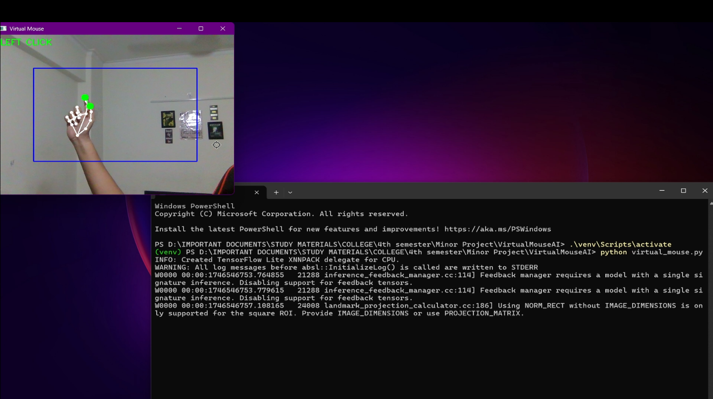
Left Click Detection
Description: Feed during a left click, showing “LEFT CLICK” text, green circles on thumb and index finger, and a connecting line.

Slide 12
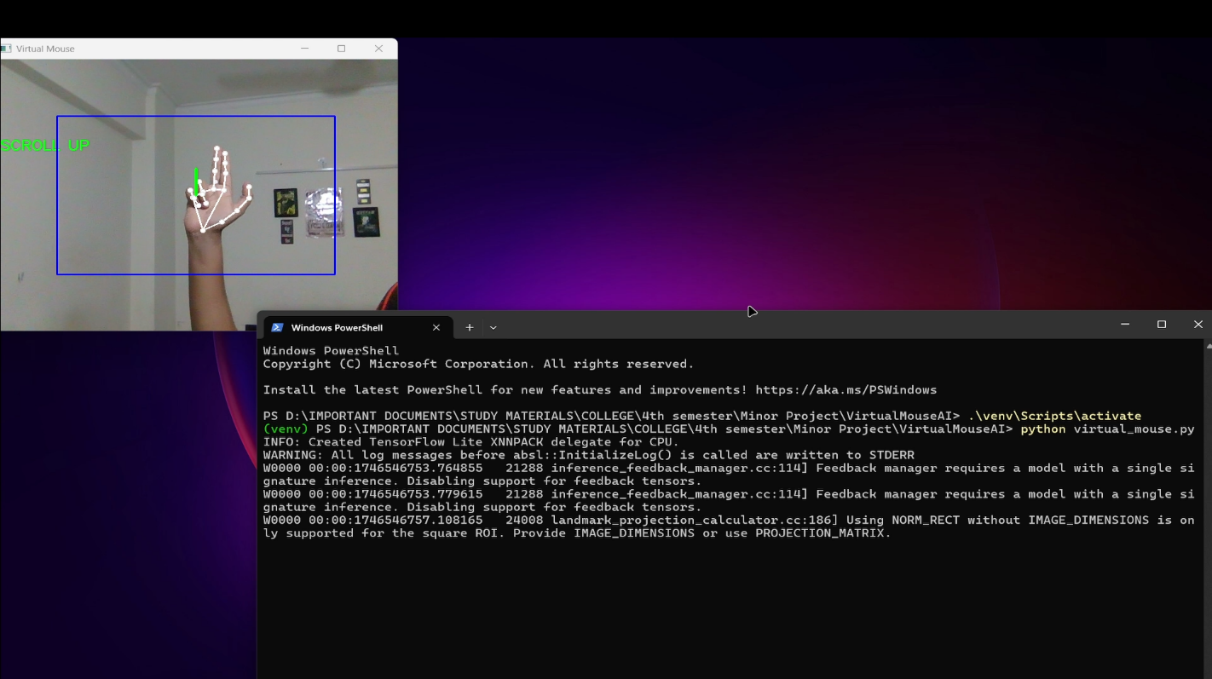
Scrolling Interface
Description: Feed during scrolling, showing “SCROLL UP” text, two-finger gesture, and a green line indicating scroll direction.

Slide 13
Results
- Smooth and accurate mouse movement
- Stable left and right click detection
- Drag and scroll working effectively
- Real-time performance with minimal lag

Slide 14
Advantages
- No physical device required
- Highly hygienic and touch-free
- User-friendly and intuitive
- Helpful for physically challenged users

Slide 15
Limitations
- Lighting and background can affect detection
- May cause hand fatigue over long use
- Accuracy can vary with rapid movements

Slide 16
Conclusion
This project successfully demonstrates a full-featured, touch-free mouse system using hand gestures, enhancing accessibility and offering an innovative way to interact with computers.

Slide 17
Future Scope
- Gesture customization options
- Integration with AR/VR
- Multi-hand gesture support
- Voice and gesture hybrid control

Slide 18
Thank You!
Questions and Discussions Welcome.

